Slide 1

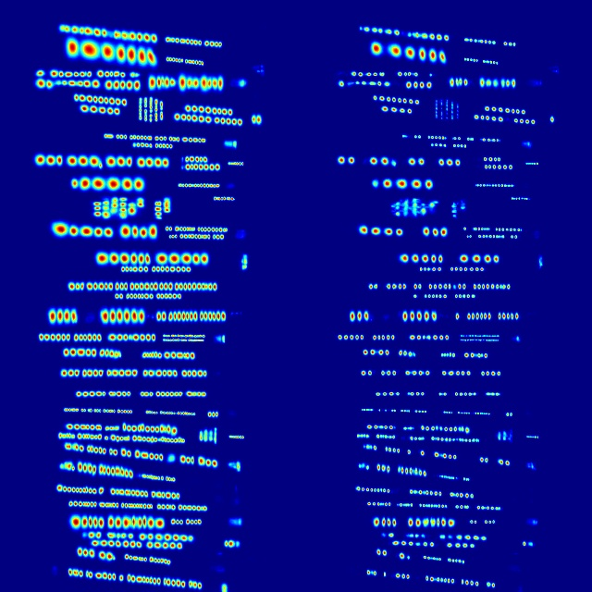

CRAFT (Character Region Awareness for Text Detection)
Input
Character Boxes
Affinity Boxes
Bounding Boxes

Slide 2



CRAFT (Character Region Awareness for Text Detection)
Character Boxes
Input
Bounding Boxes
Affinity Boxes

Slide 3



CRAFT text detection
Character boxes
Affinity boxes
Original image
Bounding Box
Cropped Jersey Number
It looks like the image has been normalized during cropping

Slide 4




Automated for all 1426 Training Tracklets
Successful
Unsuccessful
Unsuccessful
Detected signs in background
Detected other players

Slide 5
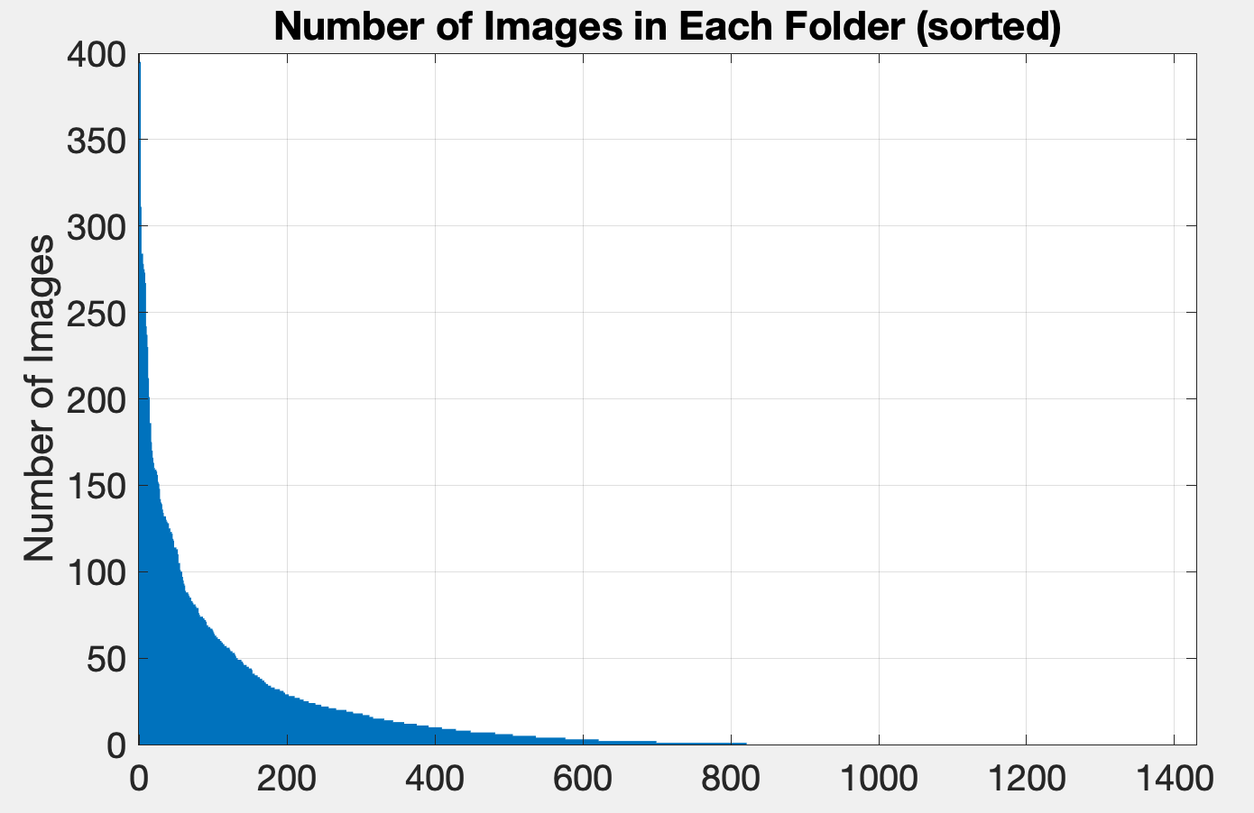
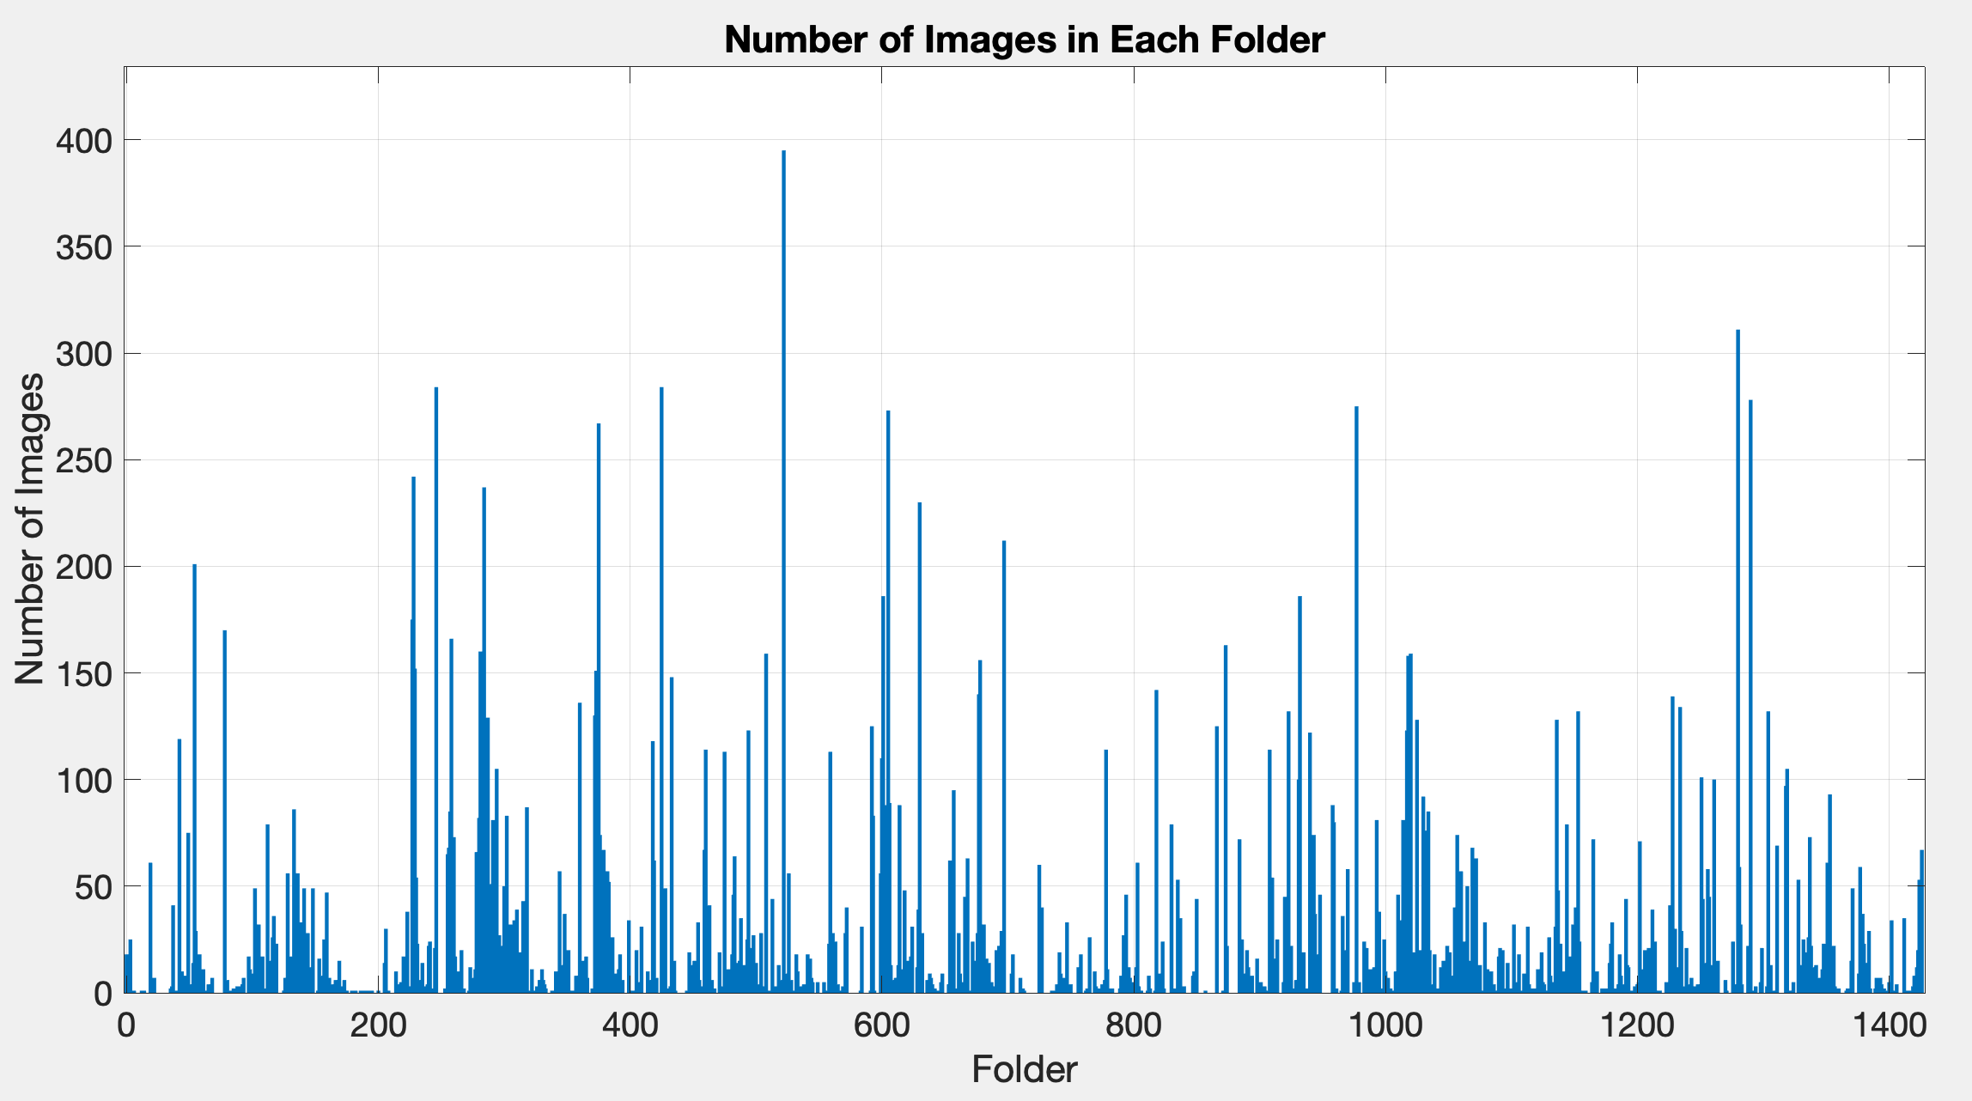
Results of CRAFT
Over 600 folders have no detected jersey numbers

Slide 6
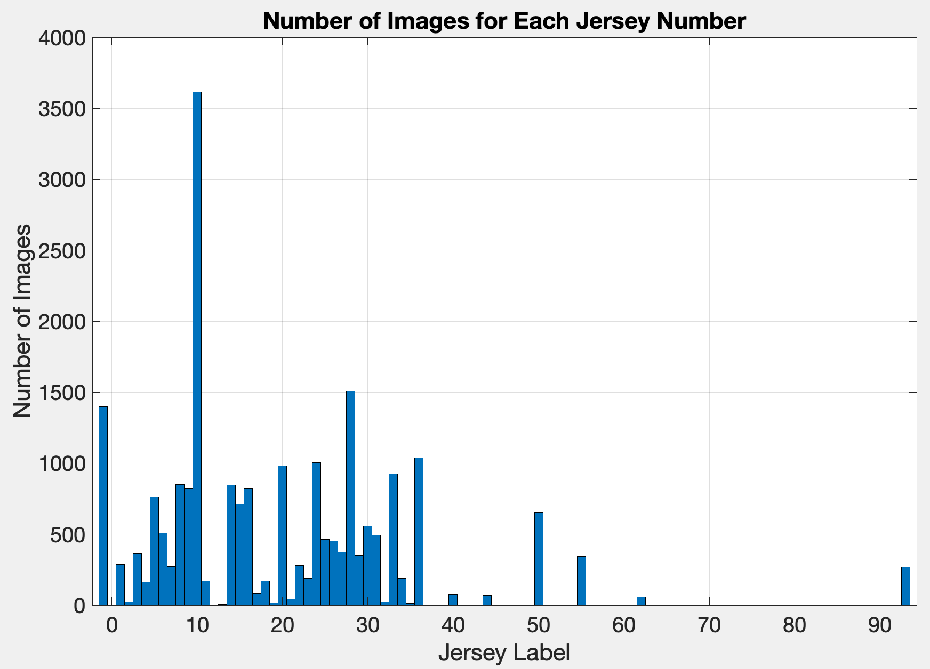
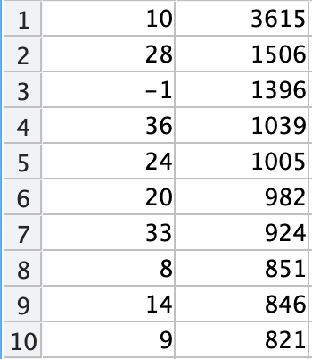
Jersey Label Frequency (cropped w/ CRAFT)
Top 10 Labels
Jersey Numbers 38 and 75 weren’t detected
Label -1 produced 1396 images
 | Label | Count
Jersey Label | -1 | 1 | 2 | 3 | 4 | 5 | 6 | 7 | 8 | 9 | 10 | 11 | 13 | 14 | 15 | 16 | 17 | 18 | 19 | 20 | 21 | 22
Image Count | 1396 | 286 | 20 | 362 | 164 | 760 | 509 | 271 | 851 | 821 | 3615 | 170 | 7 | 846 | 710 | 820 | 82 | 171 | 12 | 982 | 43 | 281
Jersey Label | 23 | 24 | 25 | 26 | 27 | 28 | 29 | 30 | 31 | 32 | 33 | 34 | 35 | 36 | 38 | 40 | 44 | 50 | 55 | 56 | 62 | 75 | 93
Image Count | 185 | 1005 | 463 | 453 | 373 | 1506 | 351 | 559 | 495 | 19 | 924 | 186 | 10 | 1039 | 0 | 72 | 66 | 652 | 343 | 1 | 58 | 0 | 267

Slide 7
Binary classification test
Jersey numbers 10 and 28 have the most data
I grouped together all folders labelled 10 into folder A
I grouped together all folders labelled 28 into folder B
Each folder was separated into training and test sets (100 images in test sets)
A_train + A_test and B_train + B_test
After training on the training images, the images in A_test and B_test were predicted with 100% accuracy
As a final test, folder 80 from the SoccerNet test set (jersey 10) was cropped with CRAFT (104 images)
The trained model labelled 96% of these images as 10

Slide 8
Conclusions and future plans (4/2/24)
There is an uneven distribution of training samples for each class
A large fraction of the data is -1 (noise for our model)
Some jersey numbers weren’t detectable by CRAFT
A simple neural network for binary classification was trained for numbers 10 and 28. It labelled 96% of test images correctly.
I can extend the model to more classes (3,4,5, etc.) and see how performance changes
Jersey numbers with few samples may need to have data augmentation to increase sample count

Slide 9
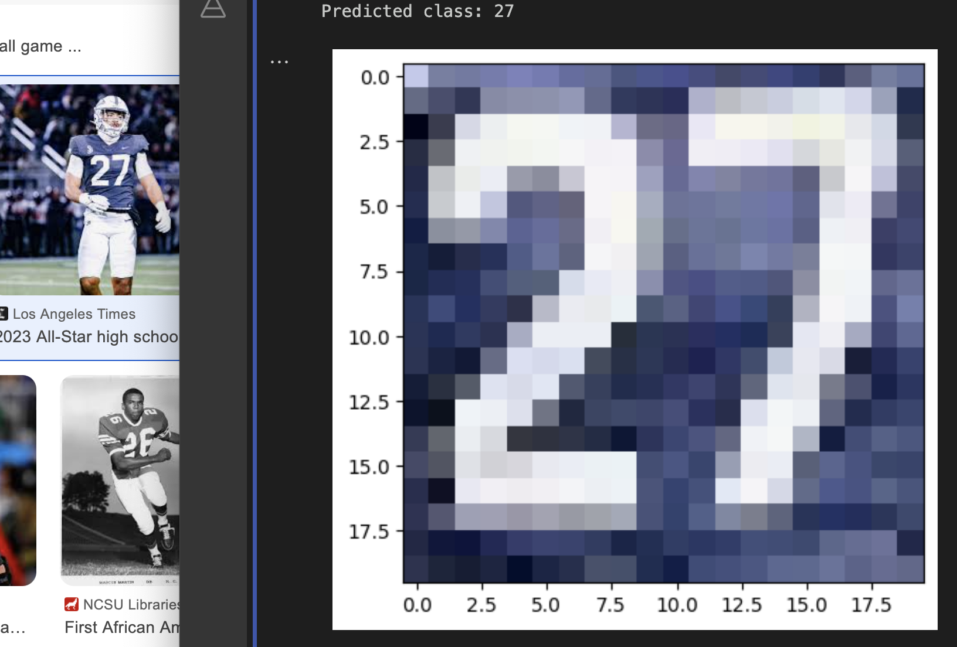
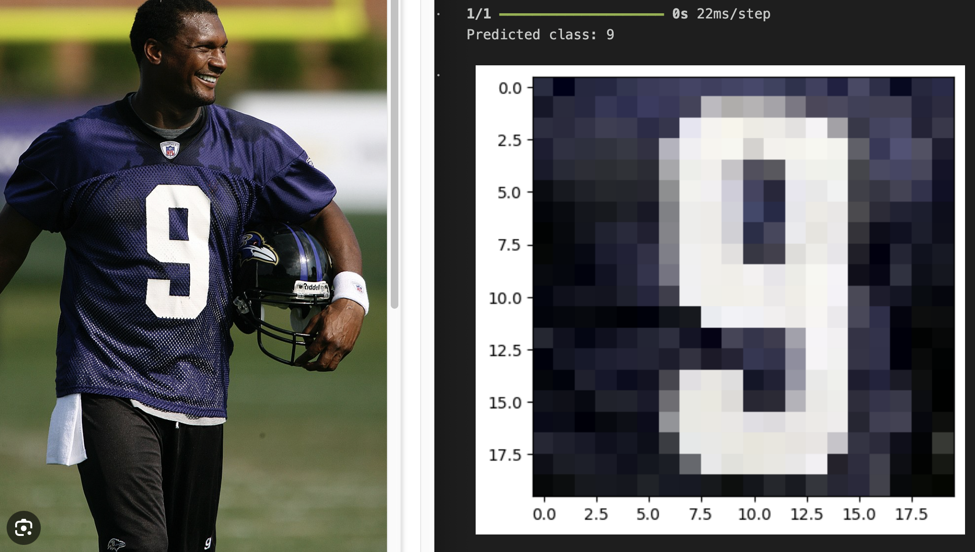
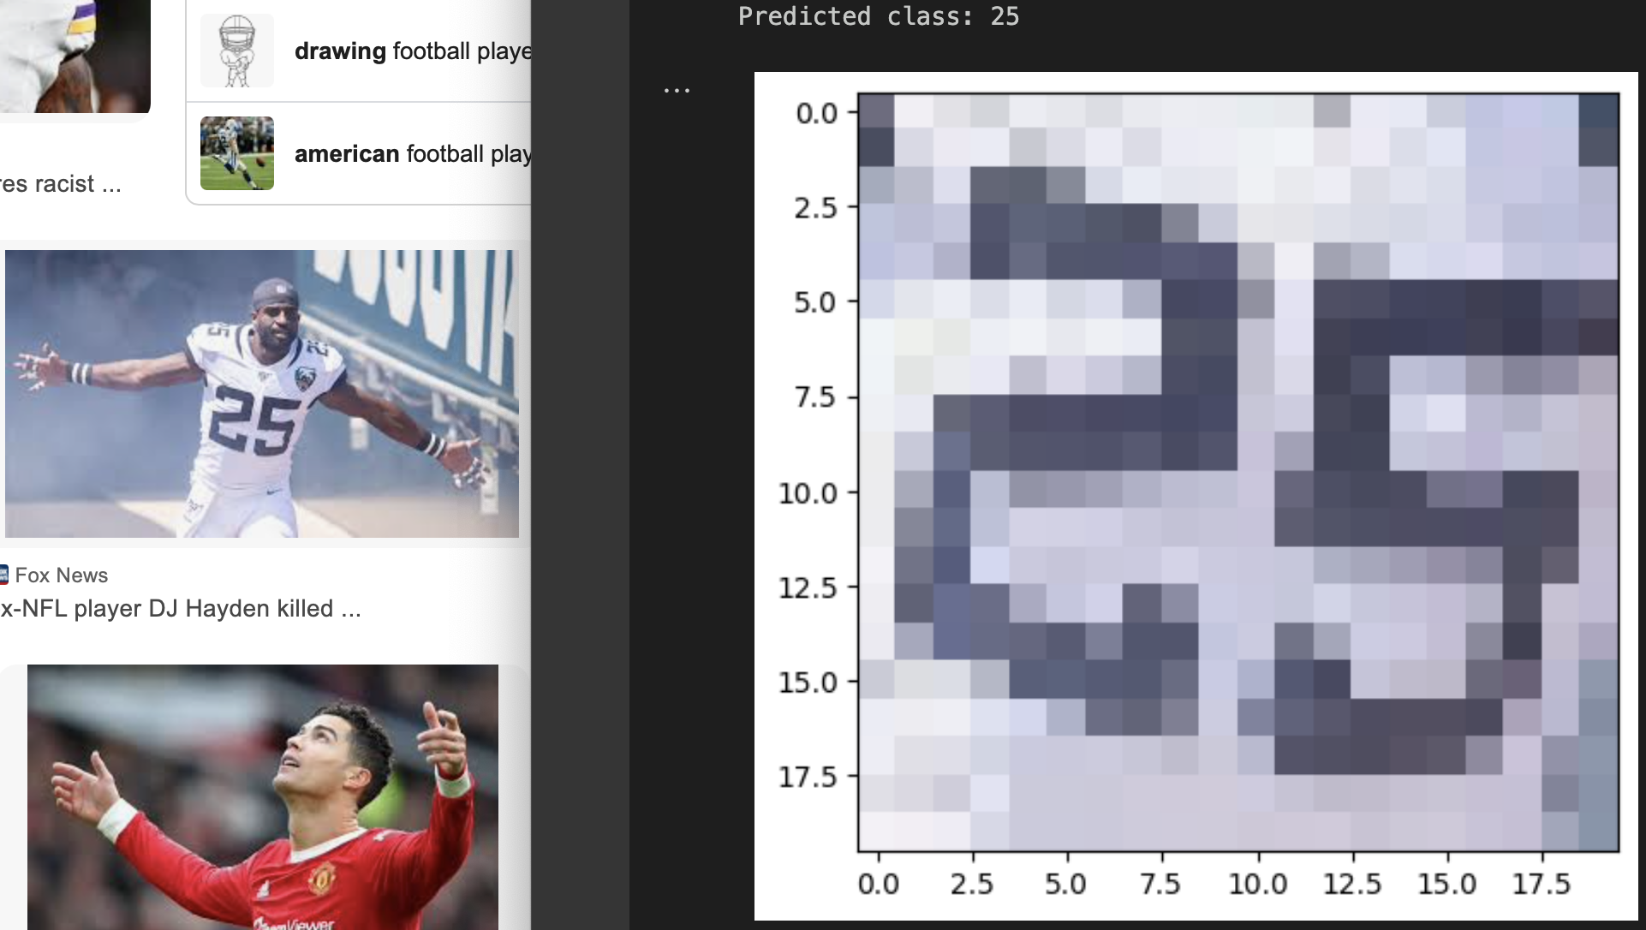

Slide 10
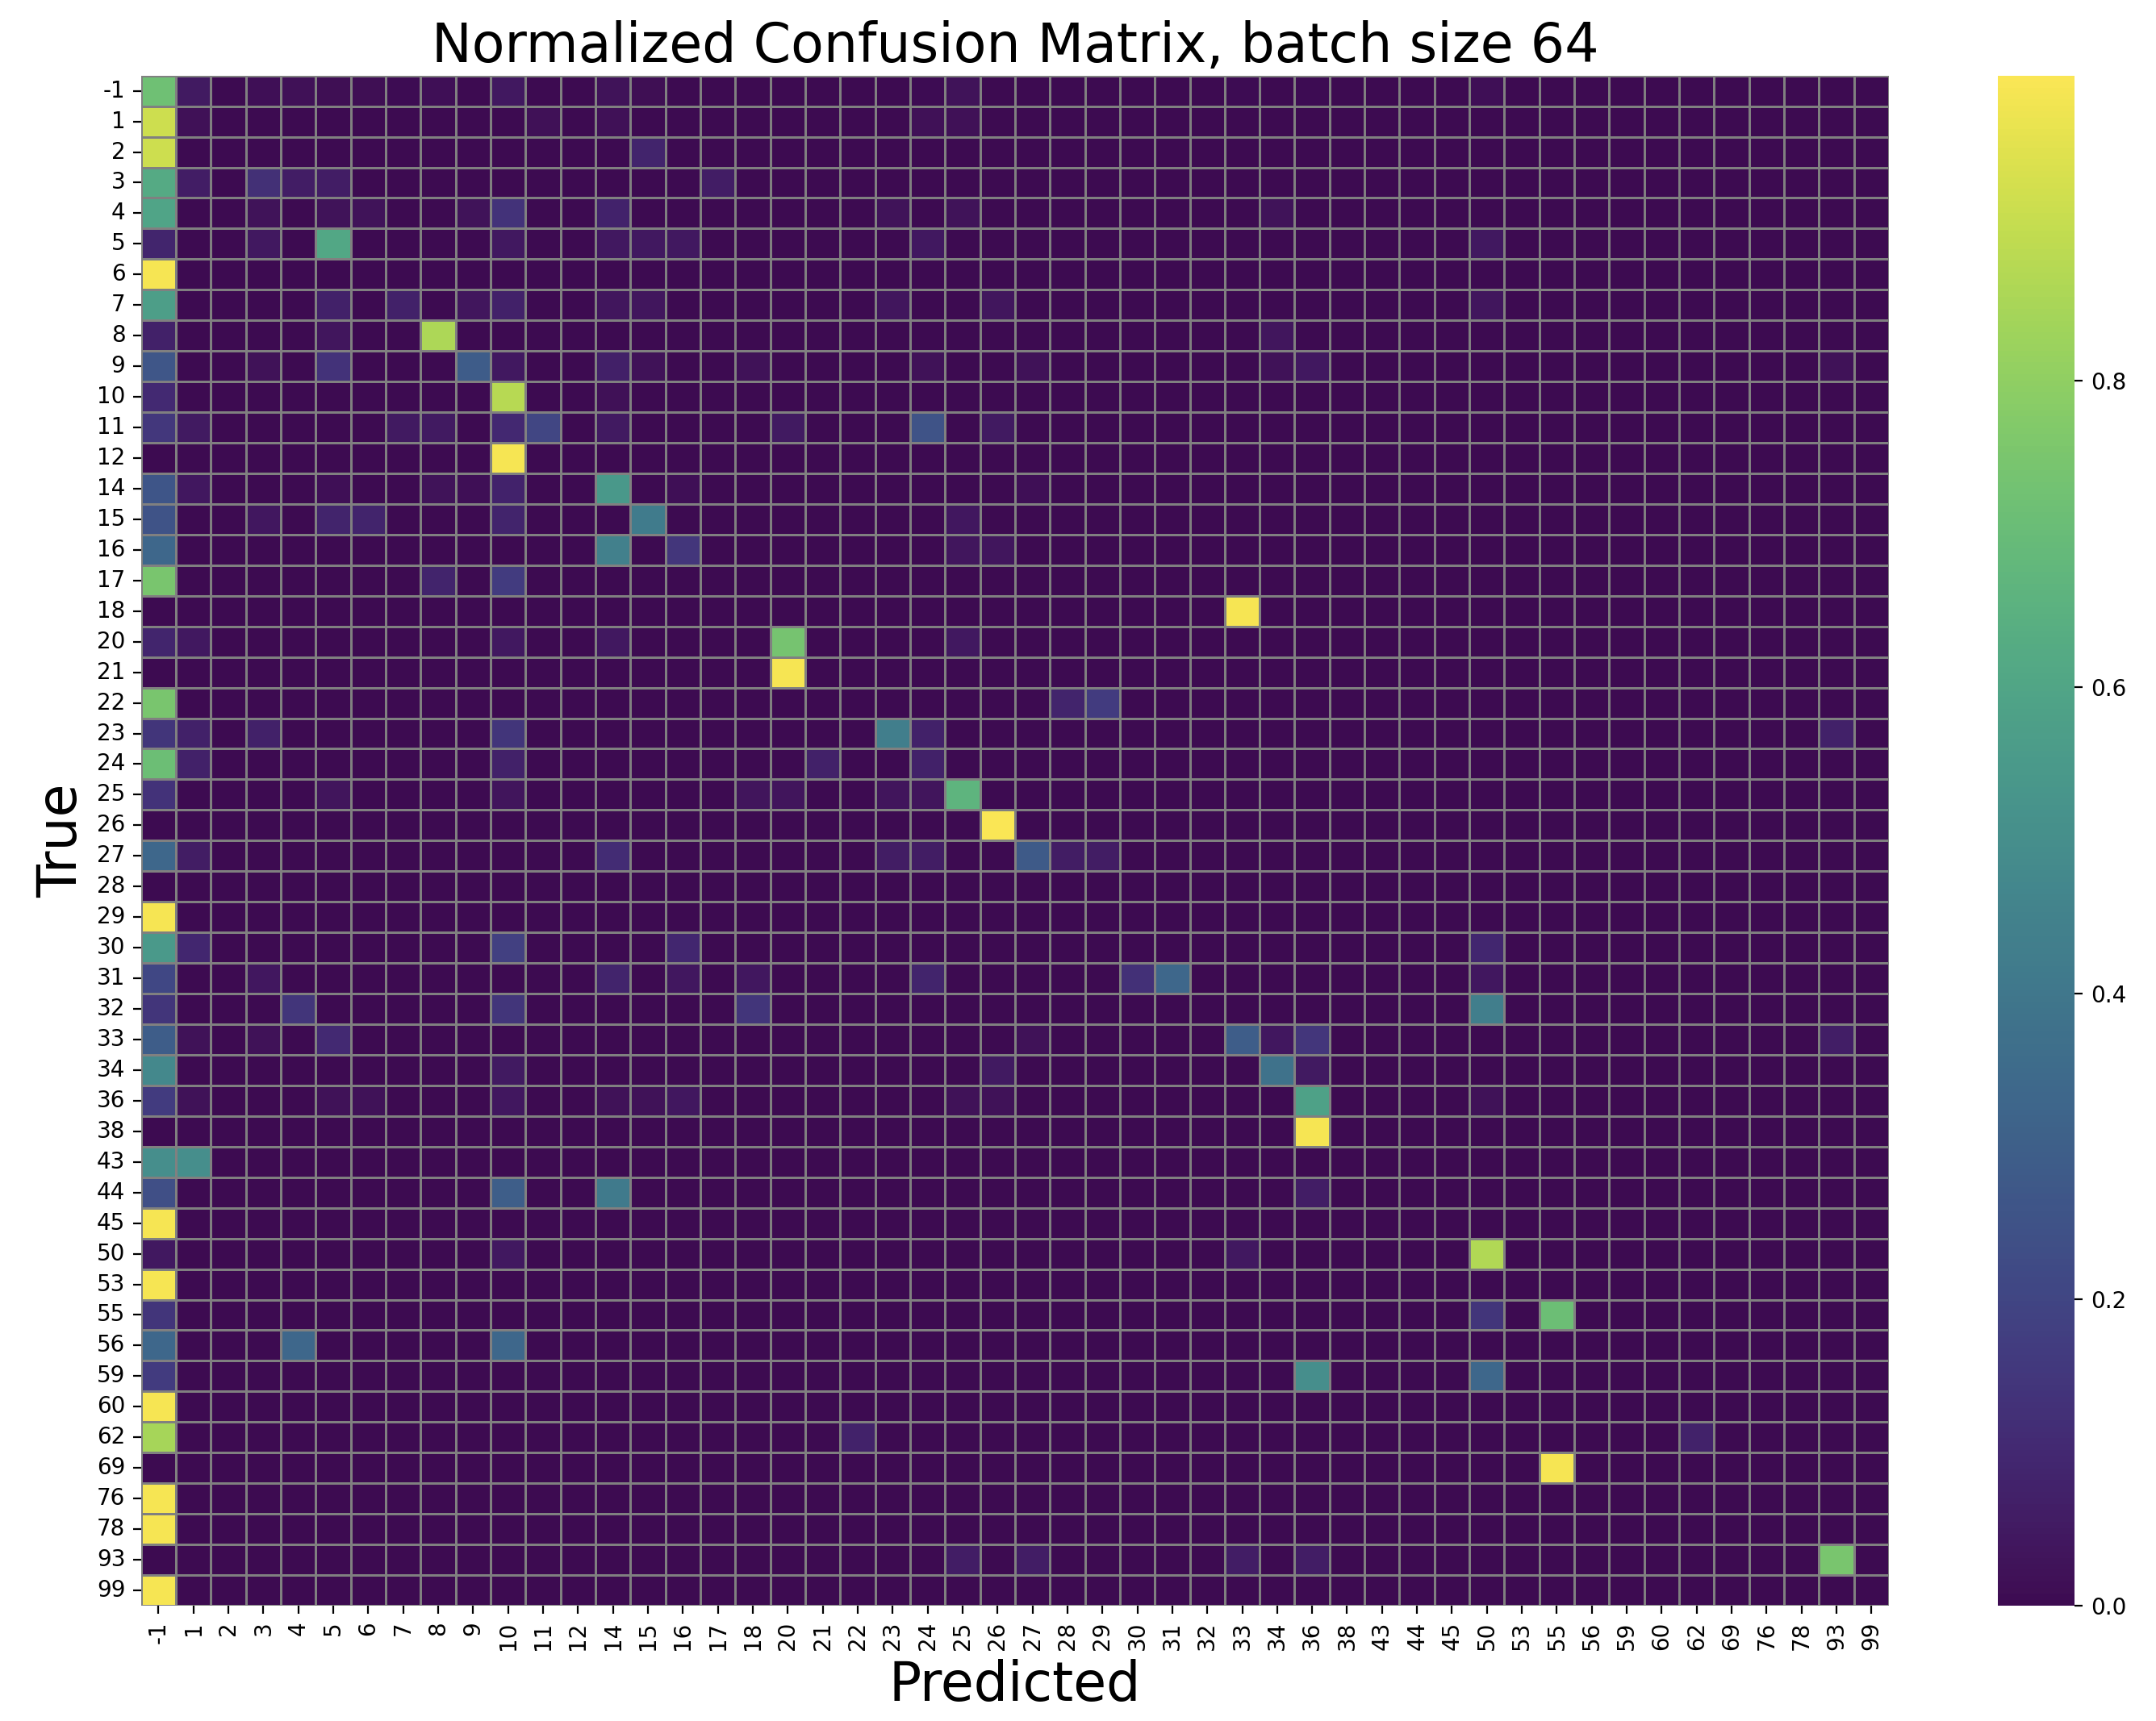
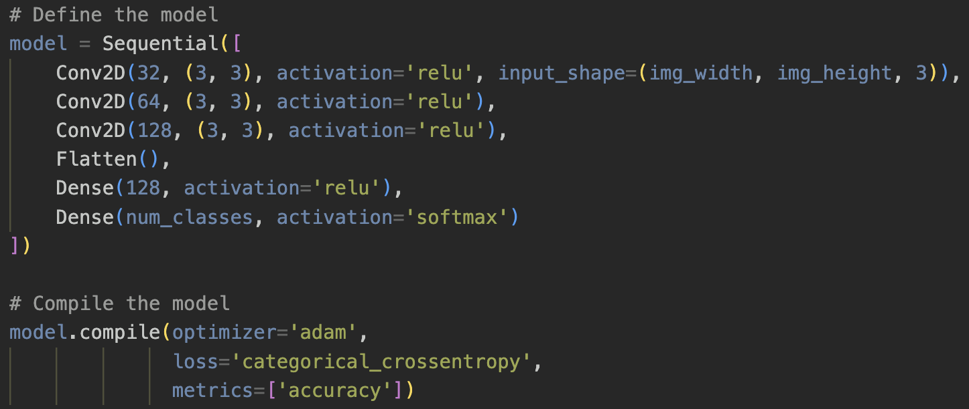
Testing on full SoccerNet test folder (cropped)
46% success on all 1211 test folders (after CRAFT)
Trained for 10 epochs, batch size 32
Consistent after retraining model
w/o 50% random inversion on training images, the success rate is only 40%
Batch size 64 has 48% success
Batch size 128 has 45% success
Batch size 32 grayscale has 46%

Slide 11
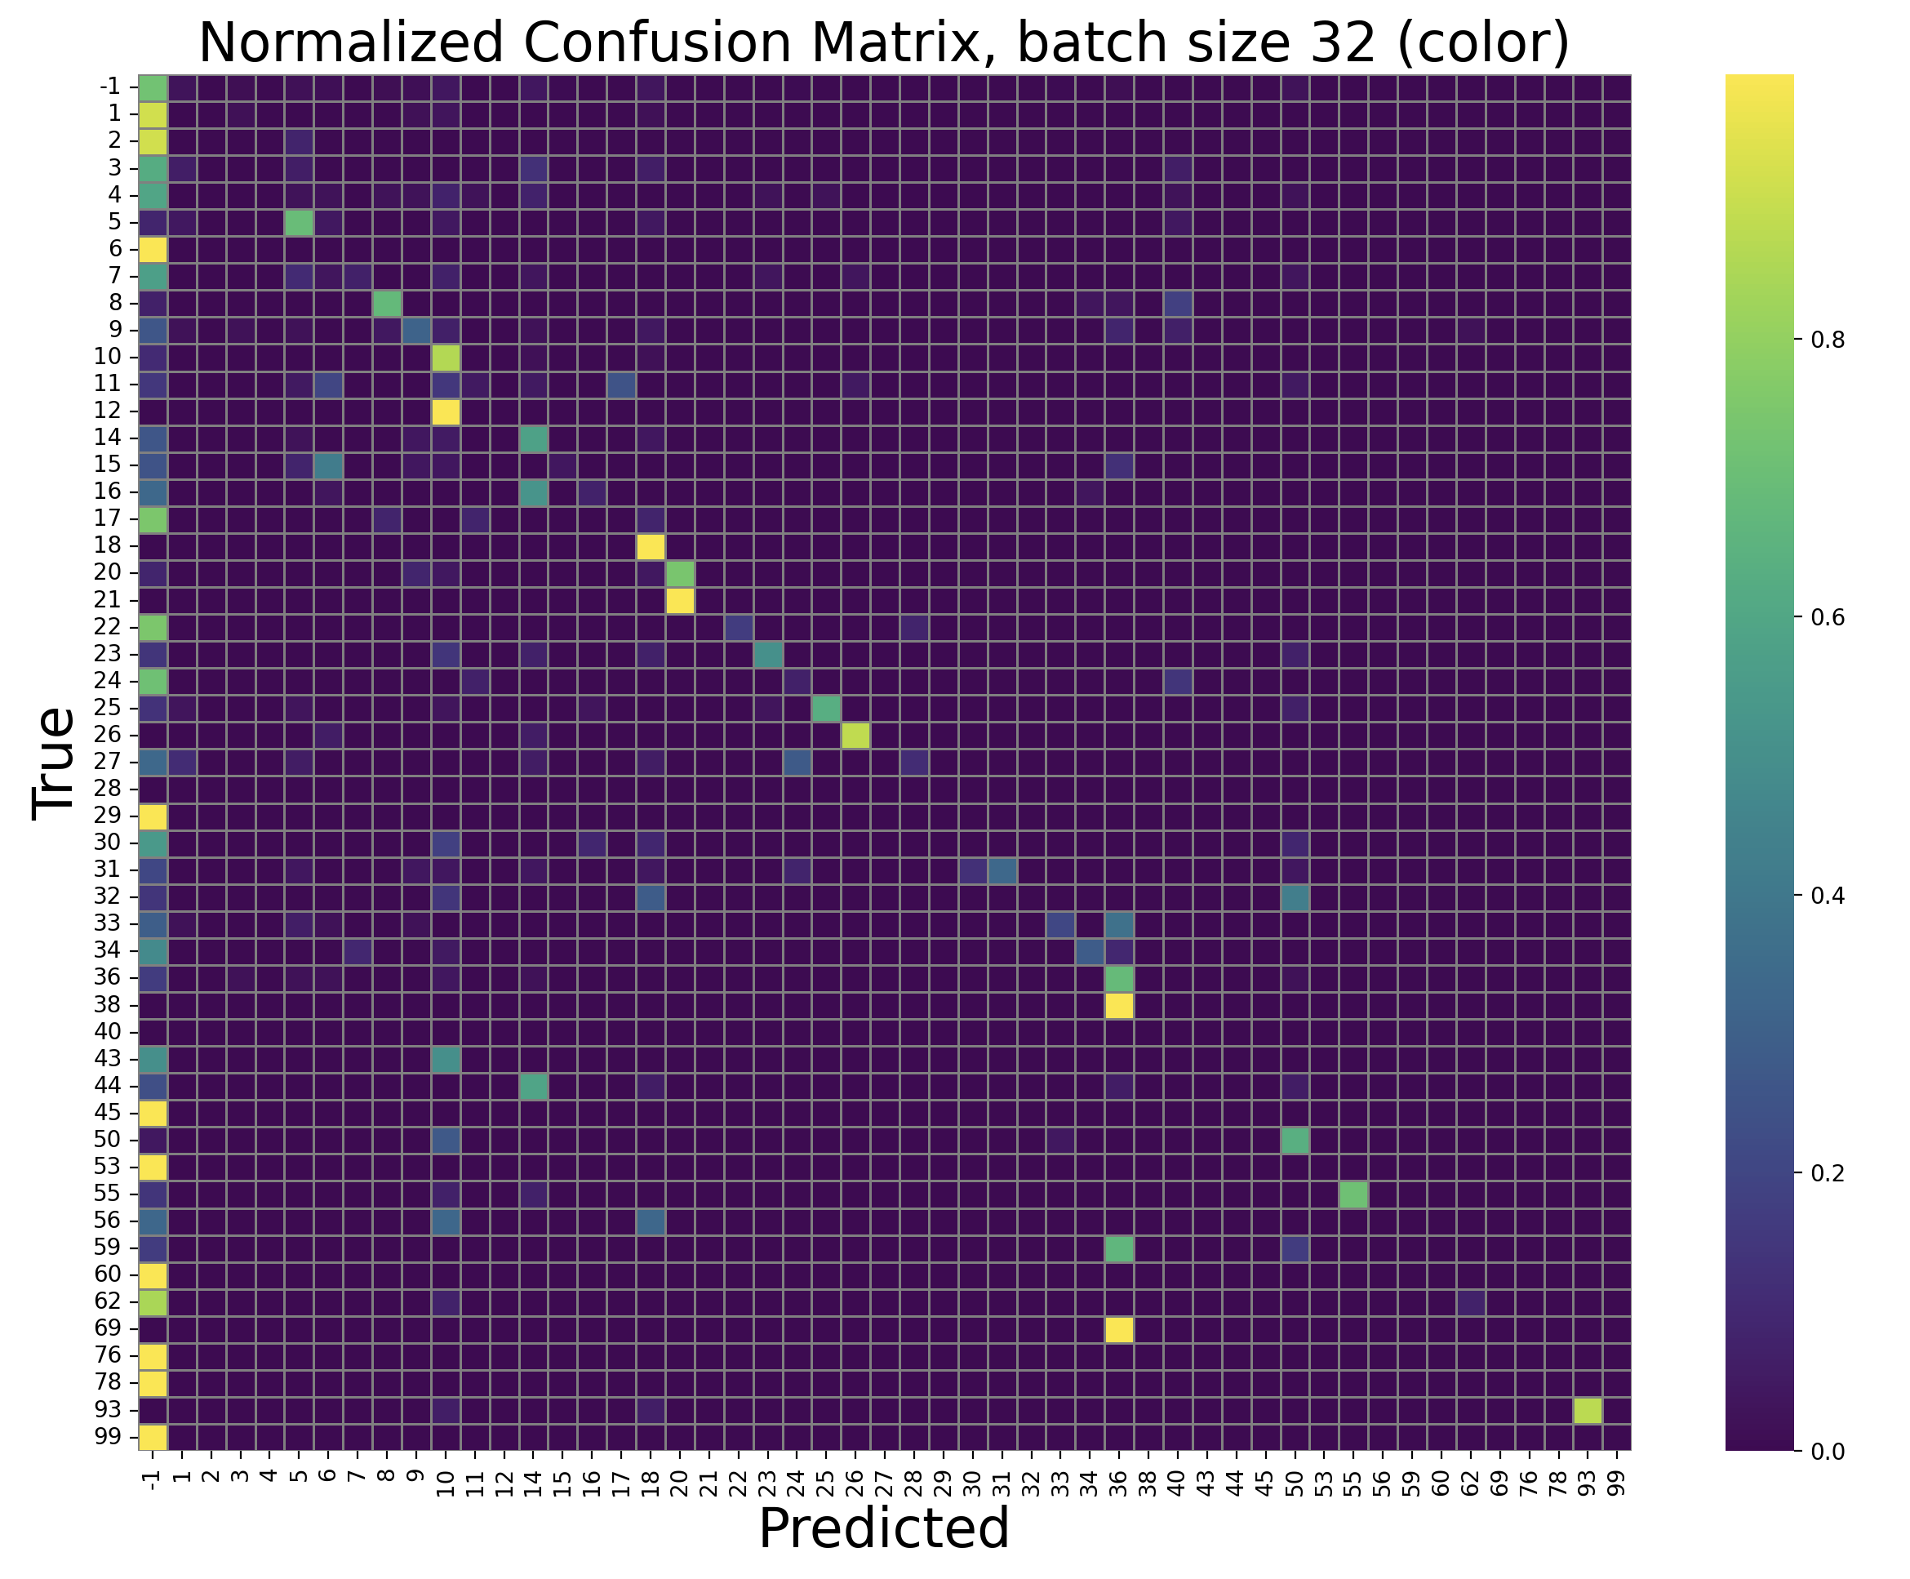
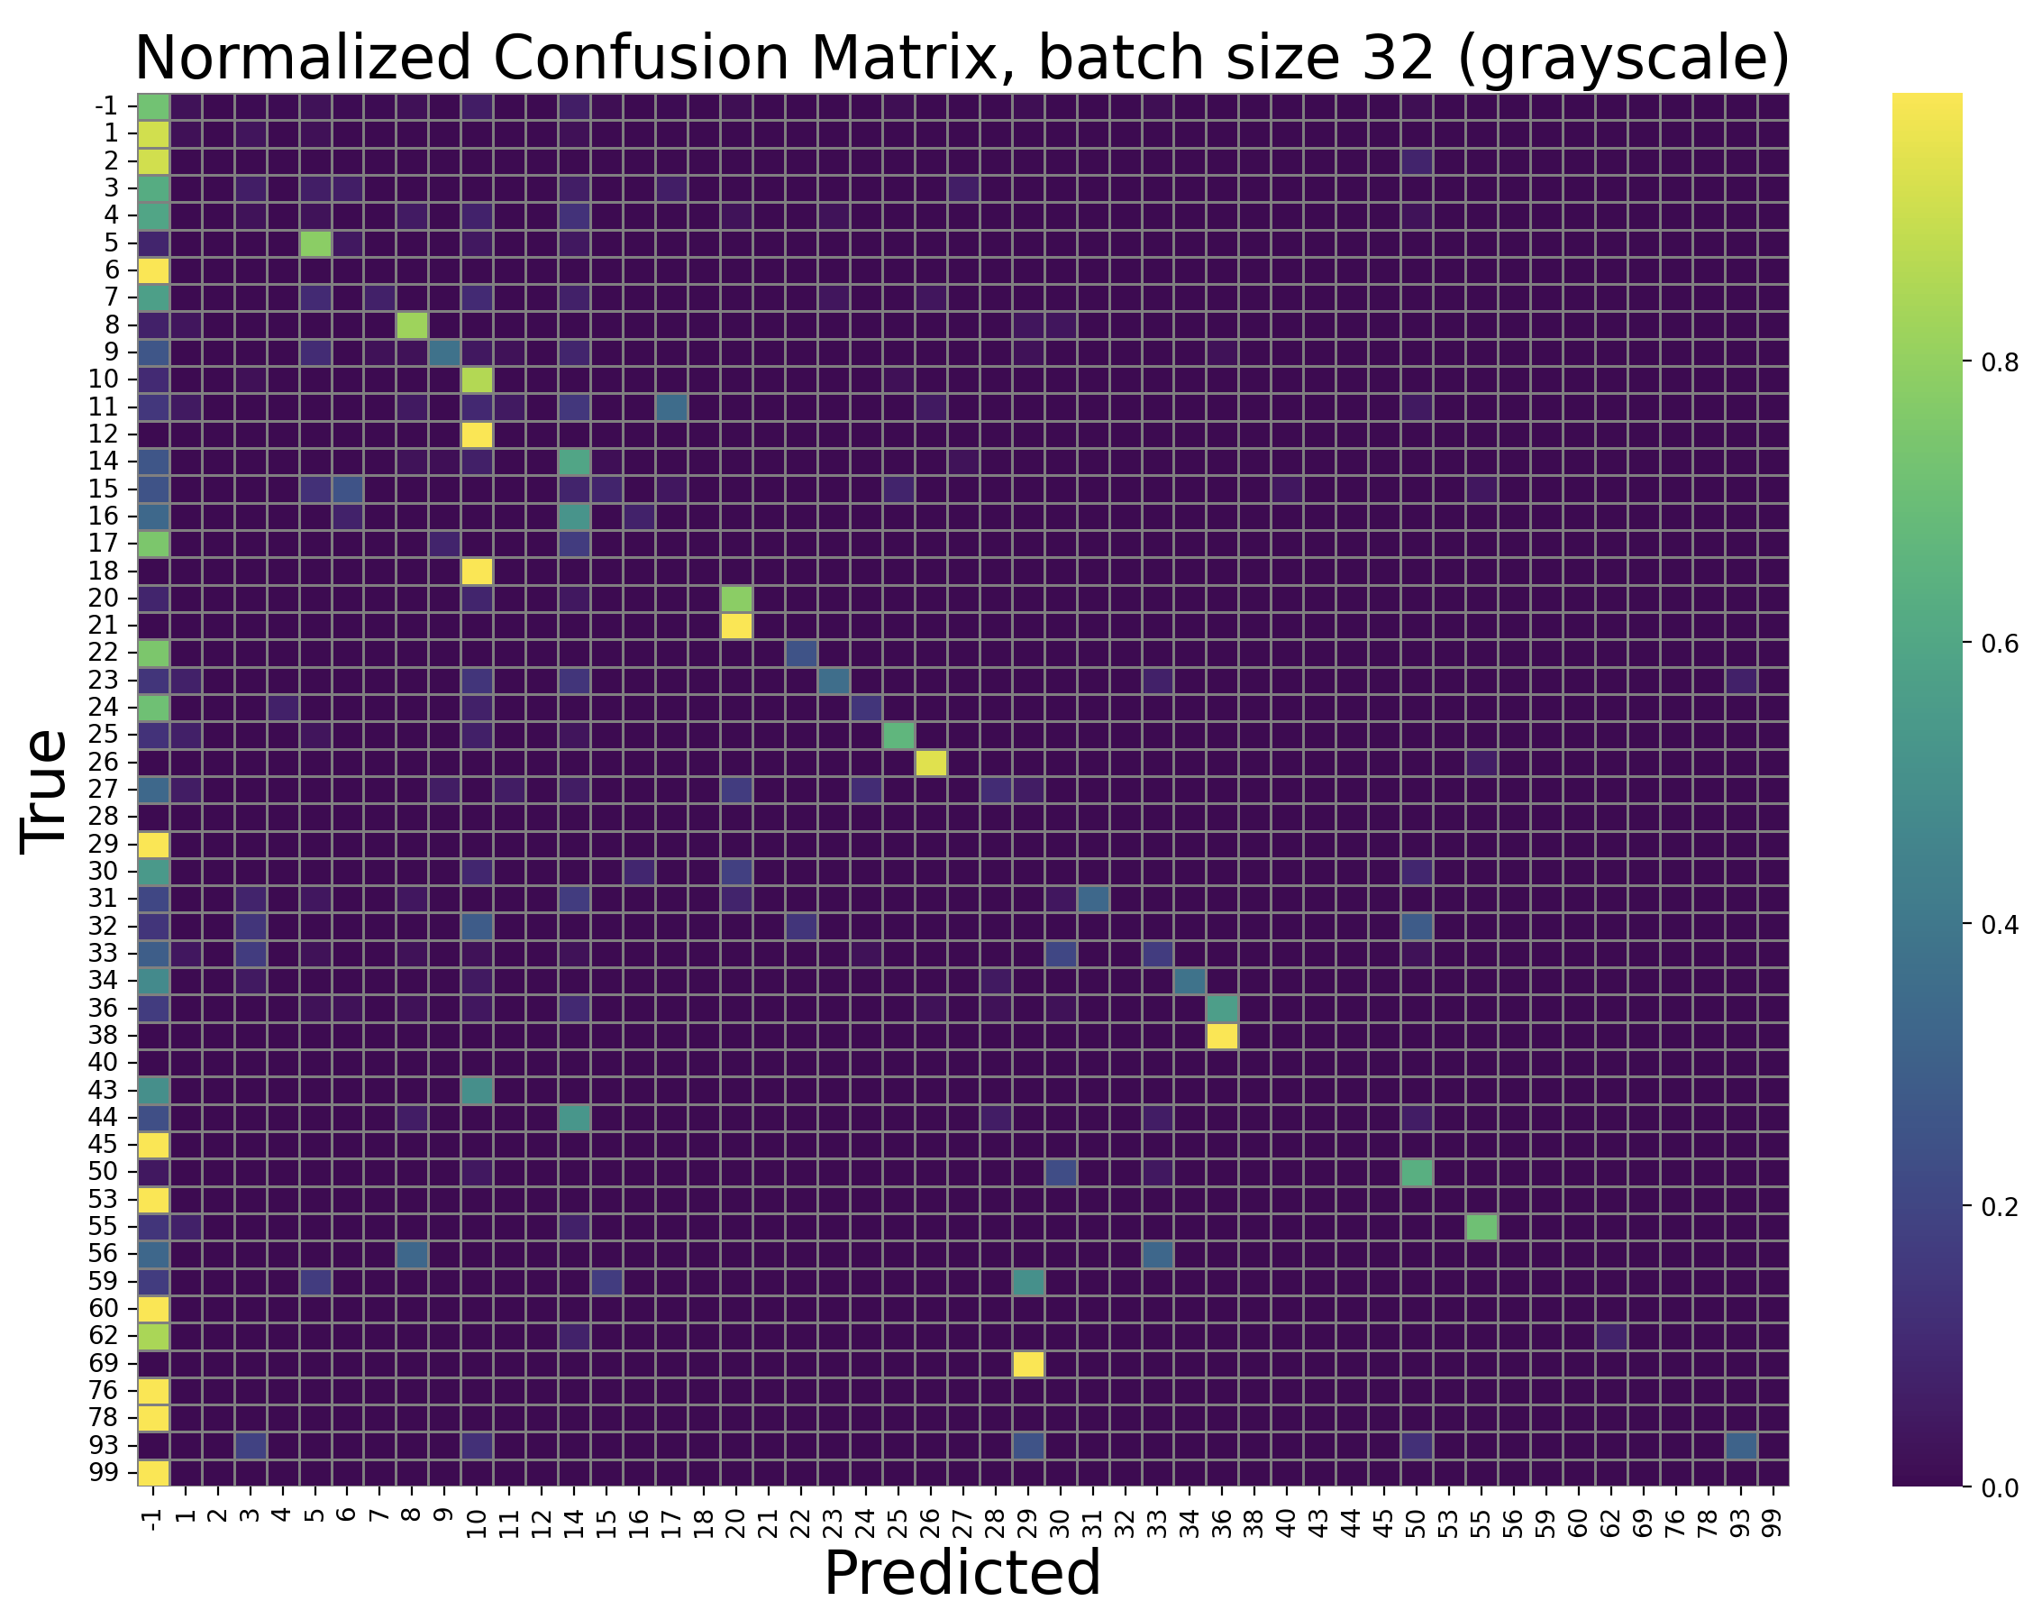
Confusion matrix, color vs grayscale

Slide 12
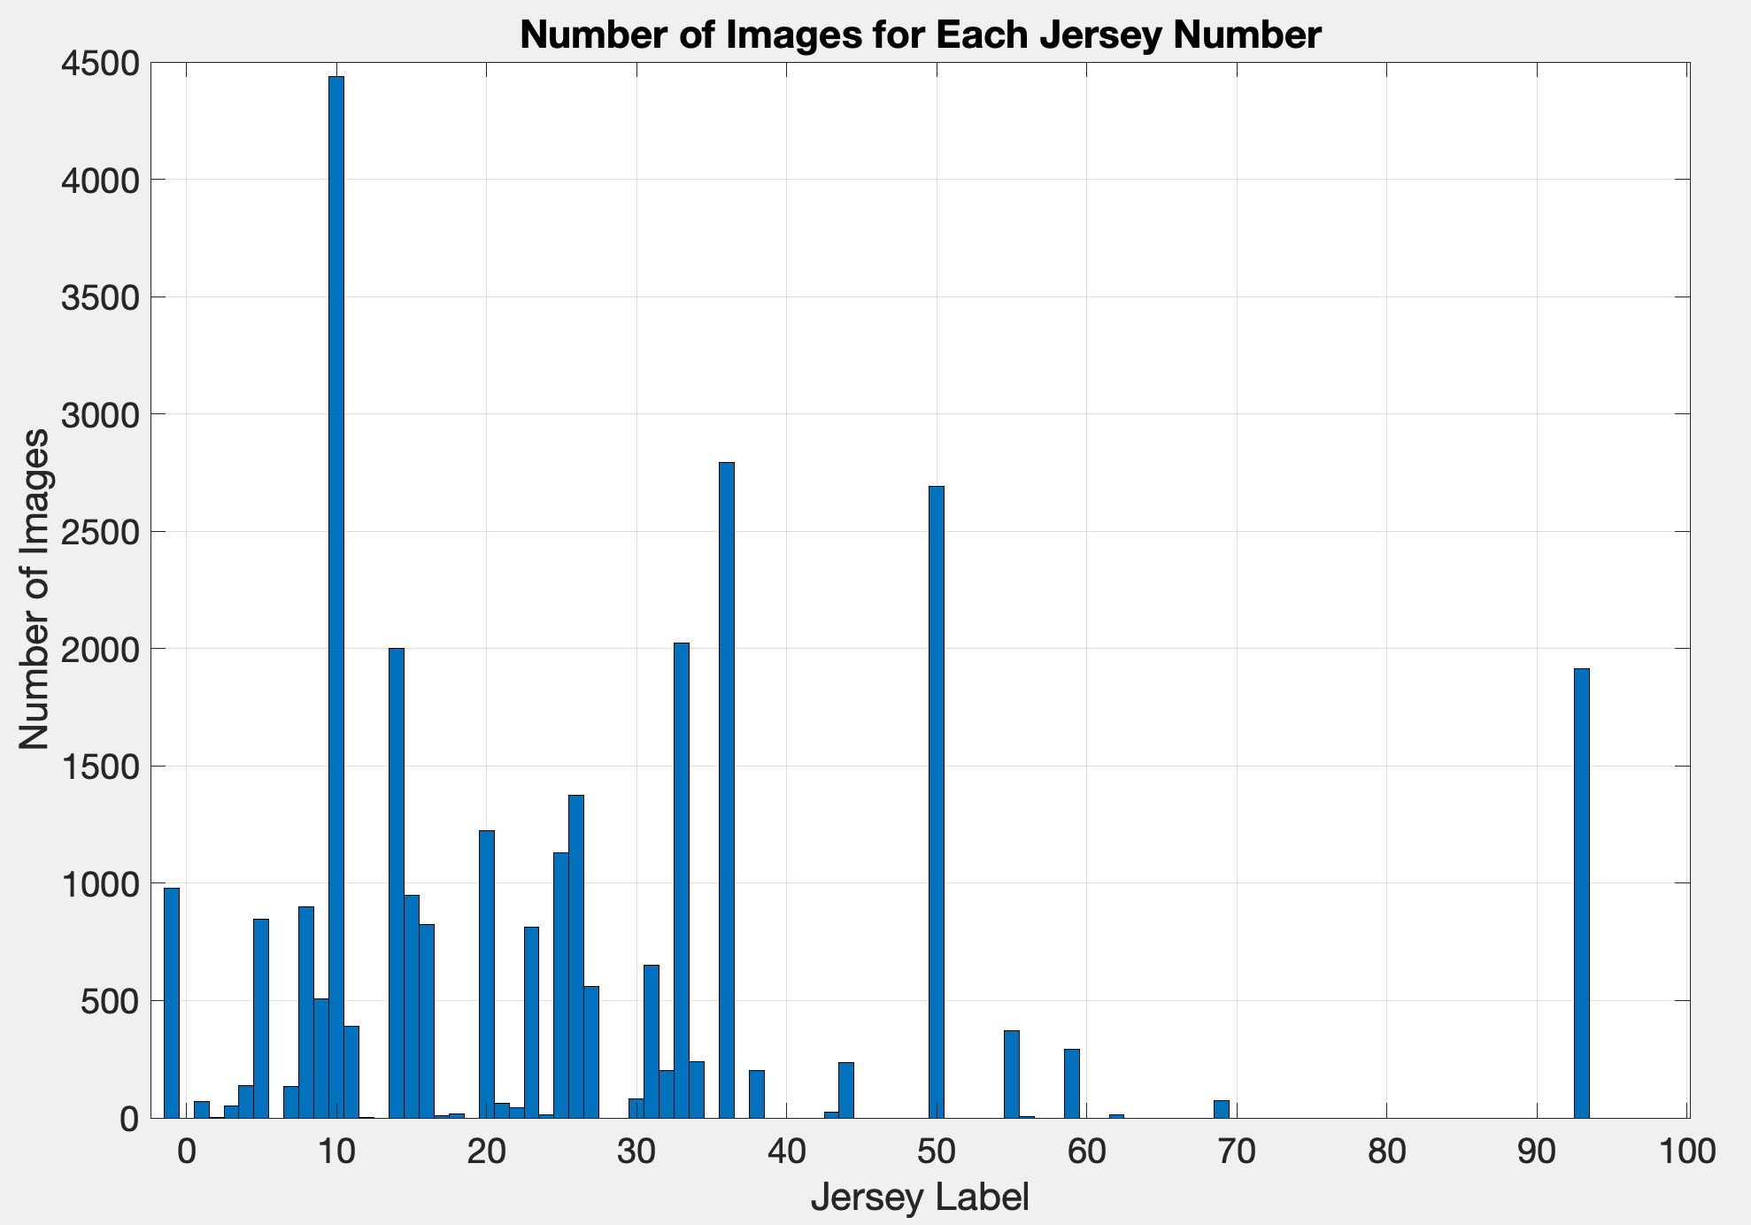
Cropped images (CRAFT)
Training Set
Test Set

Slide 13
